Slide 1
Phonetics Fundamental

Slide 2
Sound Segments
Knowing a language includes knowing the sounds of that language
Phonetics is the study of speech sounds
We are able to segment a continuous stream of speech into distinct parts and recognize the parts in other words
Everyone who knows a language knows how to segment sentences into words and words into sounds

Slide 3
Identity of Speech Sounds
Our linguistic knowledge allows us to ignore nonlinguistic differences in speech (such as individual pitch levels, rates of speed, coughs)
We are capable of making sounds that are not speech sounds in English but are in other languages

Slide 4
Identity of Speech Sounds
The science of phonetics aims to describe all the sounds of all the world’s languages
Acoustic phonetics: focuses on the physical properties of the sounds of language
Auditory phonetics: focuses on how listeners perceive the sounds of language
Articulatory phonetics: focuses on how the vocal tract produces the sounds of language

Slide 5
The Phonetic Alphabet
Spelling, or orthography, does not consistently represent the sounds of language
Some problems with ordinary spelling:
– 1. The same sound may be represented by many letters or combination of letters:
he | people | key
believe | seize | machine
Caesar | seas
see | amoeba
– 2. The same letter may represent a variety of sounds:
father badly many
village made

Slide 6
The Phonetic Alphabet
– 3. A combination of letters may represent a single sound
shoot either coat
character Thomas physics rough
deal
– 4. A single letter may represent a combination of sounds
xerox

Slide 7
The Phonetic Alphabet
– 4. Some letters in a word may not be pronounced at all
autumn pterodactyl psychology
sword
lamb write
resign
corps knot
– 5. There may be no letter to represent a sound that occurs in a word
cute use

Slide 8
The Phonetic Alphabet
In 1888 the International Phonetic Alphabet (IPA) was invented in order to have a system in which there was a one- to-one correspondence between each sound in language and each phonetic symbol
Someone who knows the IPA knows how to pronounce any word in any language

Slide 9
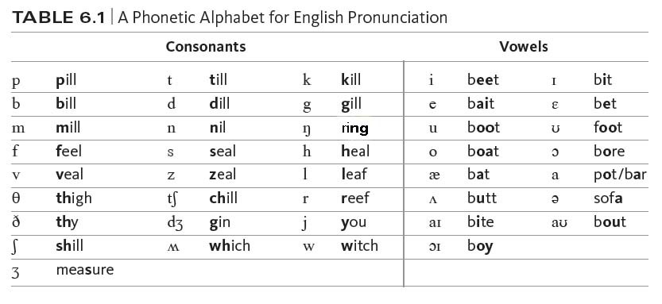
The Phonetic Alphabet
Dialectal and individual differences affect pronunciation, but the sounds of English are:

Slide 10
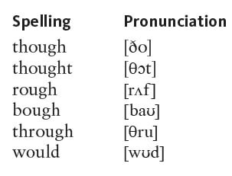
The Phonetic Alphabet
Using IPA symbols, we can now represent the pronunciation of words unambiguously:

Slide 11
Articulatory Phonetics
Most speech sounds are produced by pushing air through the vocal cords
Glottis = the opening between the vocal cords
Larynx = ‘voice box’
Pharynx = tubular part of the throat above the larynx
Oral cavity = mouth
Nasal cavity = nose and the passages connecting it to the throat and sinuses

Slide 12
Consonants: Place of Articulation
Consonants are sounds produced with some restriction or closure in the vocal tract
Consonants are classified based in part on where in the vocal tract the airflow is being restricted (the place of articulation)
The major places of articulation are:
bilabial, labiodental, interdental, alveolar, palatal, velar, uvular, and glottal

Slide 13
Consonants: Place of Articulation
Bilabials:
Produced by bringing both lips together
Labiodentals:
Produced by touching the bottom lip to the upper teeth
Interdentals
Produced by putting the tip of the tongue between the teeth

Slide 14
Consonants: Place of Articulation
Alveolars: [t] [d] [n] [s] [z] [l] [r]
All of these are produced by raising the tongue to the alveolar ridge in some way
[t, d, n]: produced by the tip of the tongue touching the alveolar ridge (or just in front of it)
[s, z]: produced with the sides of the front of the tongue raised but the tip lowered to allow air to escape
[l]: the tongue tip is raised while the rest of the tongue remains down so air can escape over the sides of the tongue (thus [l] is a lateral sound)
[r]: air escapes through the central part of the mouth; either the tip of the tongue is curled back behind the alveolar ridge or the top of the tongue is bunched up behind the alveolar ridge

Slide 15
Consonants: Place of Articulation
Palatals: [ʝ]
Produced by raising the front part of the tongue to the palate
Velars: [k] [g] [ŋ]
Produced by raising the back of the tongue to the soft palate or velum
Uvulars: [ʀ] [q] [ɢ]
Produced by raising the back of the tongue to the uvula
Glottals: [h]
Produced by restricting the airﬂow through the open glottis ([h]) or by stopping the air completely at the glottis (a glottal stop: [Ɂ])

Slide 16
Consonants: Manner of Articulation
The manner of articulation is the way the airstream is affected as it flows from the lungs and out of the mouth and nose
Voiceless sounds are those produced with the vocal cords apart so the air flows freely through the glottis
Voiced sounds are those produced when the vocal cords are together and vibrate as air passes through

Slide 17
Consonants: Manner of Articulation
The voiced/voiceless distinction is important in English because it helps us distinguish words like:
rope/robe
[rop]/[rob]
ﬁne/vine
[faɪn]/[vaɪn]
seal/zeal
[sil]/[zil]
But some voiceless sounds can be further distinguished as aspirated or unaspirated
aspirated unaspirated
pool [pul]
spool stale scale
[spul]
[stel]
[skel]
tale kale
[tel]
[kel]

Slide 18
Consonants: Manner of Articulation
Oral sounds are those produced with the velum raised to prevent air from escaping out the nose
Nasal sounds are those produced with the velum lowered to allow air to escape out the nose
So far we have three ways of classifying sounds based on phonetic features: by voicing, by place of articulation, and by nasalization
[p] is a voiceless, bilabial, oral sound
[n] is a voiced, alveolar, nasal sound

Slide 19
Consonants: Manner of Articulation
Stops: [p] [b] [m] [t] [d] [n] [k] [g] [ŋ]
Produced by completely stopping the air ﬂow in the oral cavity for a fraction of a second
All other sounds are continuants, meaning that the airﬂow is continuous through the oral cavity
Fricatives: [f] [v] [s] [z] [h]
Produced by severely obstructing the airﬂow so as to cause friction

Slide 20
Consonants: Manner of Articulation
Aﬀricates: [t] [d]
Produced by a stop closure that is released with a lot of friction
Liquids: [l] [r]
Produced by causing some obstruction of the airstream in the mouth, but not enough to cause any real friction
Glides: [j] [w]
Produced with very little obstruction of the airstream and are always followed by a vowel

Slide 21
Consonants: Manner of Articulation
Approximants: [w] [j] [r] [l]
Sometimes liquids and glides are put together into one category because the articulators approximate a frictional closeness but do not actually cause friction
Trills and ﬂaps: [r]* [ɾ]
Trills are produced by rapidly vibrating an articulator
Flaps are produced by a ﬂick of the tongue against the alveolar ridge
Clicks:
Produced by moving air in the mouth between various articulators
The disapproving sound tsk in English is a consonant in Zulu and some other southern African languages
The lateral click used to encourage a horse in English is a consonant in Xhosa
*The textbook uses [r] to represent the central liquid as in the word ready rather than as a trill

Slide 22
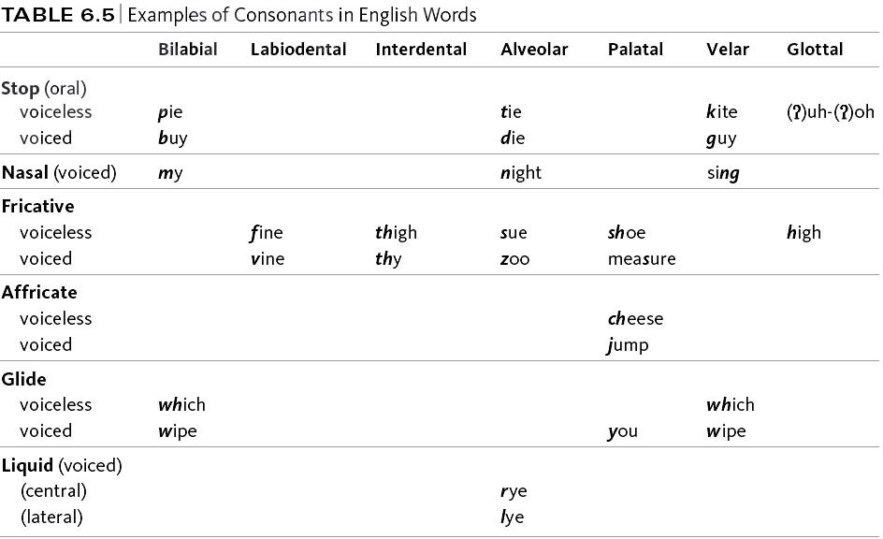

Slide 23
Vowels
Vowels are classified by how high or low the tongue is, if the tongue is in the front or back of the mouth, and whether or not the lips are rounded
High vowels: [i] [u]
Mid vowels: [e] [o]
Low vowels: [a]

Slide 24

Vowels
Round vowels: Produced by rounding the lips
English has only back round vowels, but other languages such as French and Swedish have front round vowels
Diphthongs: [ai] [au]
A sequence of two vowel sounds (as opposed to the monophthongs we have looked at so far)
Nasalization:
Vowels can also be pronounced with a lowered velum, allowing air to pass through the nose
In English, speakers nasalize vowels before a nasal sound, such as in the words
beam, bean, and bingo
The nasalization is represented by a diacritic, an extra mark placed with the symbol:

Slide 25
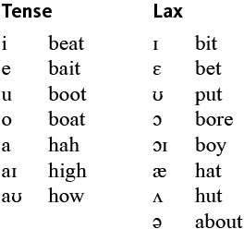
Vowels
Tense vowels:
Are produced with
greater tension in the tongue
May occur at the end of words
Lax vowels:
Are produced with less tongue tension
May not occur at the end of words

Slide 26
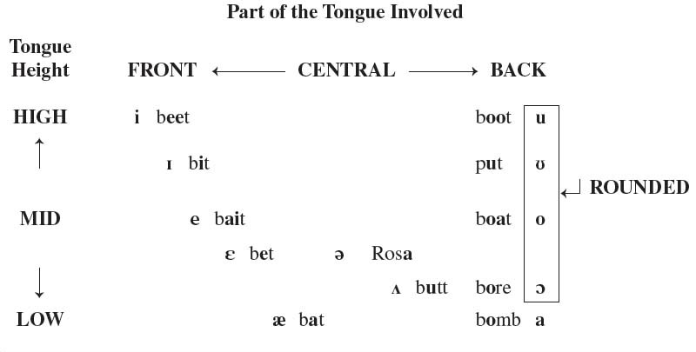
Vowels

Slide 27
Major Phonetic Classes
Noncontinuants: the airstream is totally obstructed in the oral cavity
Stops and affricates
Continuants: the airstream flows continuously out of the mouth
All other consonants and vowels
Obstruents: the airstream has partial or full obstruction
Non-nasal stops, fricatives, and affricates
Sonorants: air resonates in the nasal or oral cavities
Vowels, nasal stops, liquids, and glides

Slide 28
Major Phonetic Classes: Consonantal
Consonantal: there is some restriction of the airﬂow during articulation
– All consonants except glides
Consonantal sounds can be further subdivided:
– Labials: [p] [b] [m] [f] [v] [w] [ʍ]
Articulated with the lips
– Coronals: [t] [d] [n] [s] [z] [l] [r]
Articulated by raising the tongue blade

Slide 29


Major Phonetic Classes
Consonantal categories cont.:
– Anteriors: [p] [b] [m] [f] [v] [t] [d] [n] [s] [z]
Produced in the front part of the mouth (from the alveolar area forward)
Sibilants: [s] [z] ]
Produced with a lot of friction that causes a hissing sound, which is a mixture of high-­‐frequency sounds
Syllabic Sounds: sounds that can function as the core of a syllable
– Vowels, liquids, and nasals

Slide 30
Prosodic Features
Prosodic, or suprasegmental features of sounds, such as length, stress and pitch, are features above the segmental values such as place and manner of articulation
Length: in some languages, such as Japanese, the length of a consonant or a vowel can change the meaning of a word:
biru [biru] “building”
saki [saki] “ahead”
biiru [biːru] “beer”
sakki [sakːi] “before”

Slide 31
Prosodic Features
Stress: stressed syllables are louder, slightly higher in pitch, and somewhat longer than unstressed syllables
The noun digest has the stress on the first syllable
The verb digest has the stress on the second syllable
English is a stress-timed language, meaning that at least one syllable is stressed in an English word
French functions differently, so when English speakers learn French they put stress on certain syllables which contributes to their foreign accent

Slide 32
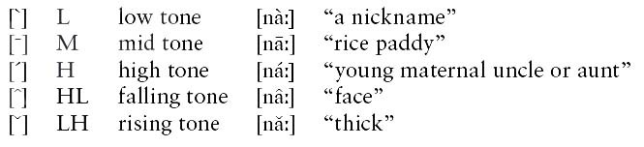
Tone and Intonation
Tone languages are languages that use pitch to contrast the meaning of words
For example, in Thai, the string of sounds [naː] can be said with 5 diﬀerent pitches and can thus have 5 diﬀerent meanings:

Slide 33
Tone and Intonation
Intonation languages (like English) have varied pitch contour across an utterance, but pitch is not used to distinguish words
However, intonation may affect the meaning of a whole sentence:
John is here said with falling intonation is a statement
John is here said with rising intonation is a question

